Slide 1


Physical Design Internship
DeDepartment of Electronics and Communication Engineering
PnR implementation of SPI using Qflow
May 2024 – July 2024
By
Rudra Pratap Rohan
215807038

Slide 2
Agenda
Certificate of Completion
Acknowledgements
Project Introduction
Project Details
Conclusion

Slide 3
Acknowledgement
I am deeply grateful to Maven Silicon for the incredible opportunity to intern in the field of VLSI . This experience has been profoundly transformative, allowing me to sharpen my skills, acquire invaluable practical knowledge, and dive into the dynamic realm of physical design of IC. The support and mentorship provided throughout this internship have been crucial in my growth, both professionally and personally. I sincerely appreciate the chance to learn from such a talented team and to contribute to impactful projects. This opportunity has greatly enhanced my understanding and enthusiasm for backend of ASIC design flow, and I am excited to build upon the strong foundation that Maven Silicon has helped me establish.

Slide 4

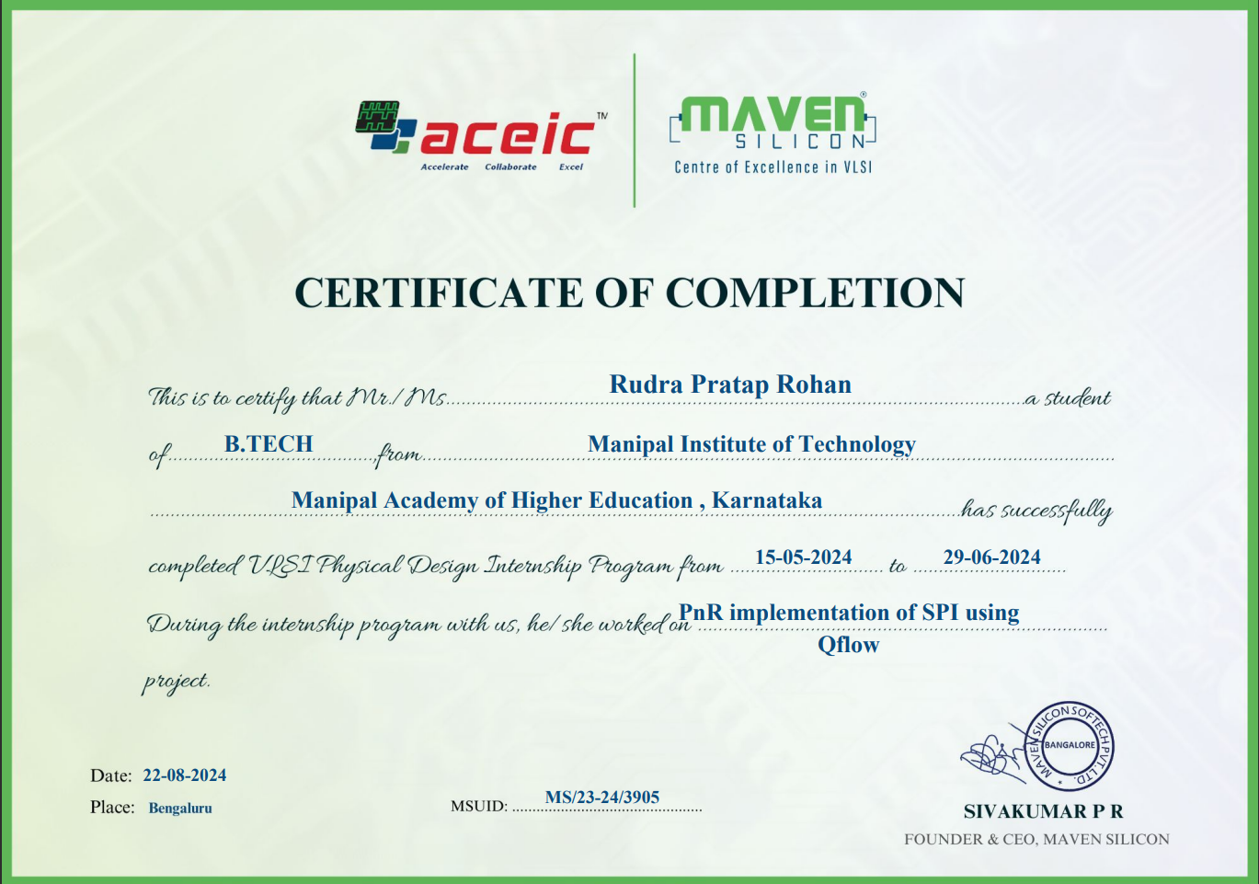
Power of communication

Slide 5
What is SPI?
SPI stands for Serial Peripheral Interface. It is a protocol that is synchronous serial communication. It is used to communicate between the peripheral devices i.e. input and output devices and microcontrollers. It is allowed to transfer high-speed data. It is popular with digital communication applications and embedded systems. SPI can transfer the data and receive data from one device to another device at a time.
Notes:
A Serial Peripheral Interface (SPI) facilitates short-distance communication between peripheral integrated circuits and microcontrollers. In this article, we will understand the components of SPI, applications of Serial Peripheral Interface (SPI), and more.

Slide 6
Components of SPI
Serial Peripheral Interface (SPI) is the process of synchronous serial communication protocol. It is mainly used for connecting the microcontrollers to peripheral devices like sensors, displays, and memory chips. It facilitates the full-duplex, synchronous serial communication between one or more slave devices and a microcontroller.
Serial clock (SCK). The clock signal that is generated by the controller to provide the timing signal necessary to keep the controller and peripheral in sync. The clock is also referred to as CLK, SCLK or other terms. Clock labeling has not changed with the new naming conventions.
Peripheral out/controller in (POCI). The signal that carries the data from the peripheral to the controller. Until recently, this signal was commonly referred to as MISO (master in/slave out). In some instances, MISO refers to main in/subnode out.
Chip select (CS). The signal determines which peripheral should be made active when the controller needs to communicate with one of multiple peripherals. At one time, the signal was commonly referred to as SS (slave select).

Slide 7
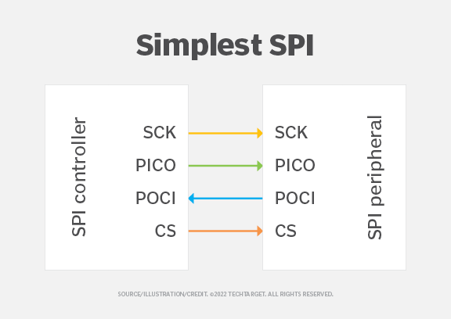
SPI architecture
Serial. Data is transmitted over a single line one bit at a time in sequential order. This is in contrast to parallel communication, in which data is transmitted in parallel across multiple lines. Serial interfaces have simpler wiring, can support longer cables and are less prone to crosstalk between cable wires.
Synchronous. Data is transmitted in a continuous data stream that works in conjunction with a timing signal used by both the transmitter and receiver. In contrast, asynchronous transmissions can be random or irregular and do not rely on a common clock. Synchronous communications are faster and come with less overheard than asynchronous communications.
Full-duplex. Data can be transmitted in both directions at the same time. This is in contrast to half-duplex communications that support bidirectional communication but with only one node transmitting data at a time.

Slide 8
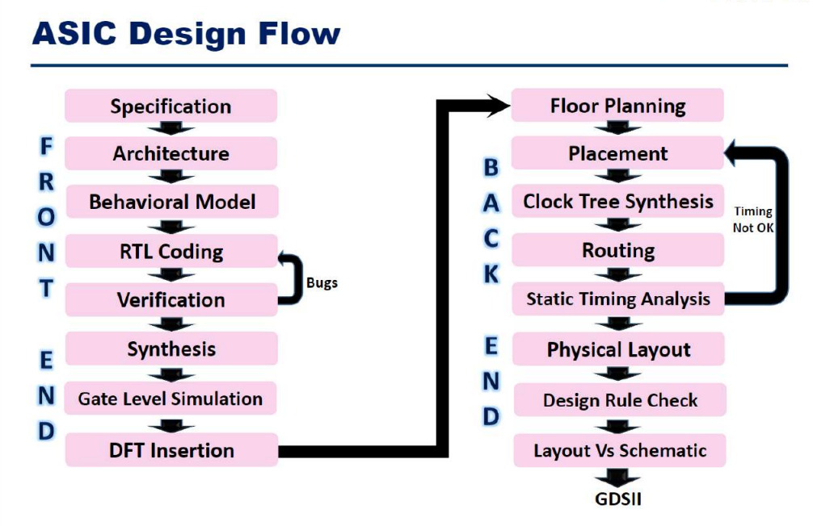

Slide 9
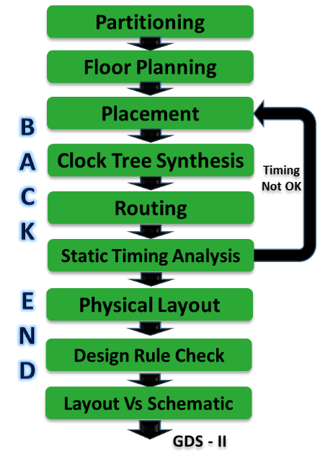
Physical Design Flow

Slide 10
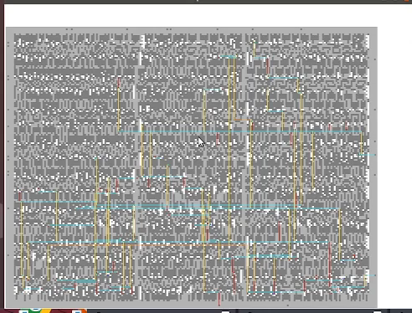
Qflow
Qflow is a complete tool chain for synthesizing digital circuits starting from verilog source and ending in physical layout for a specific target fabrication process. In the world of commercial electronics, digital synthesis with a target application of a chip design is usually bundled into large EDA software systems like Cadence or Synopsys. As commercial electronics designers need to maintain cutting-edge performance, these commercial toolchains get more and more expensive, and have largely priced themselves out of all but the established integrated circuit manufacturers. This leaves an unfortunate gap where startup companies and small businesses cannot afford to do any sort of integrated circuit design. The algorithms for digital synthesis are all tied up in closed-source software, and development is controlled by a few EDA software vendors.

Slide 11
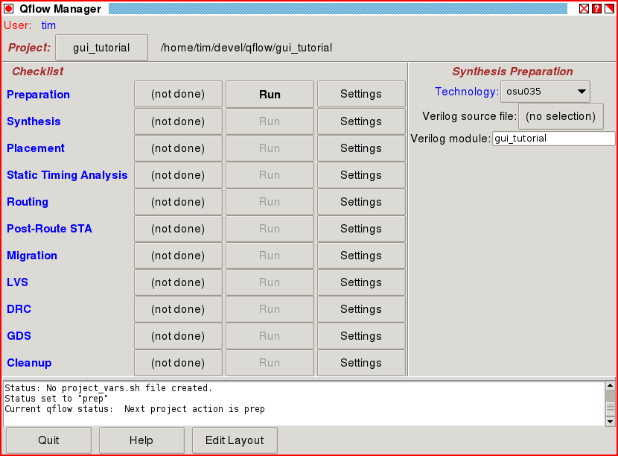
Qflow GUI
It consists of
• Yosys: Verilog parser / synthesis
• Graywolf : cell and pin placement
• Qrouter : Detail router
• Magic: Final layout generator /viewer

Slide 12
Verilog Source Files
The SPI design is described using the following Verilog source files:
• spi_clgen.v
• spi_defines.v
• spi_shift.v
• spi_slave.v
• spi_top.v
• timescale.v
These files describe the behavior and structure of the SPI components, including clock generation, shift registers, and slave interface

Slide 13
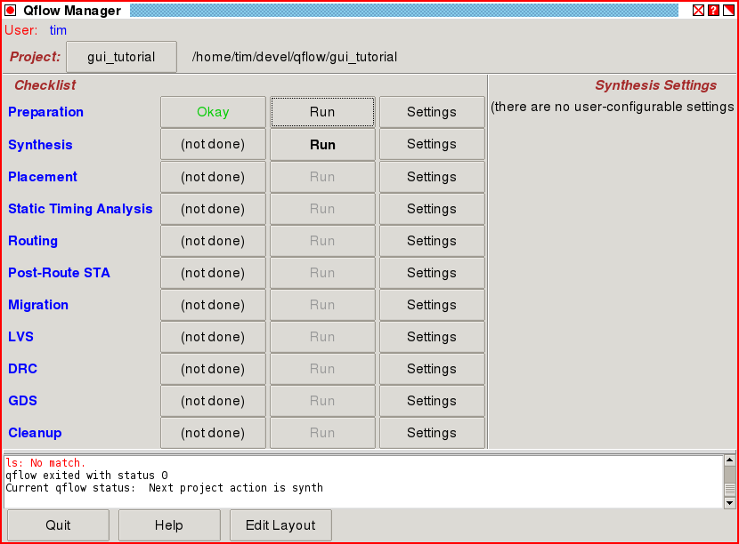
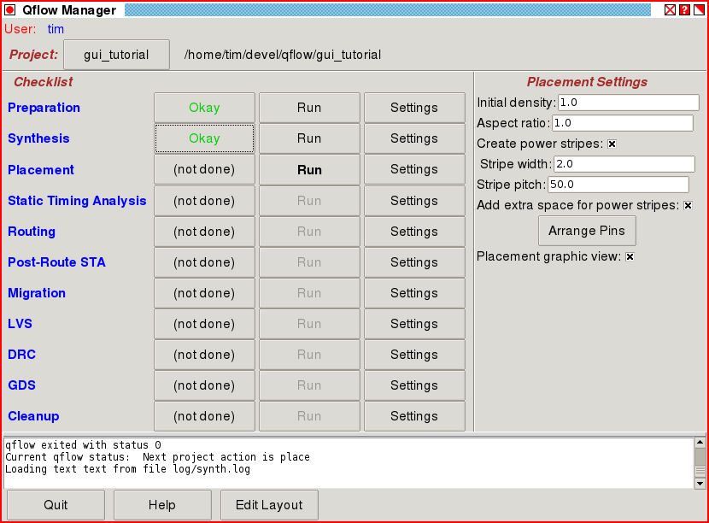
Setting up for synthesis
Because qflow was started as "qflow gui" and with no other options, qflow starts in an unitialized state. The step is set to "Preparation", where the user can control what the input source to the synthesis is, and what technology to target. The default technology is "osu035", from the set of technologies bundled with and installed with qflow. There is no verilog source file, and the module name is just set to the name of the project, which is the name of the current working directory.

Slide 14
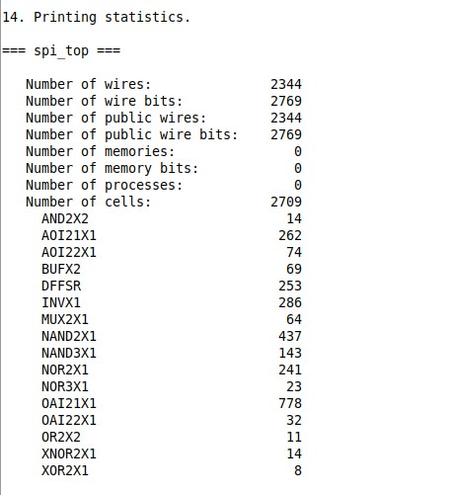
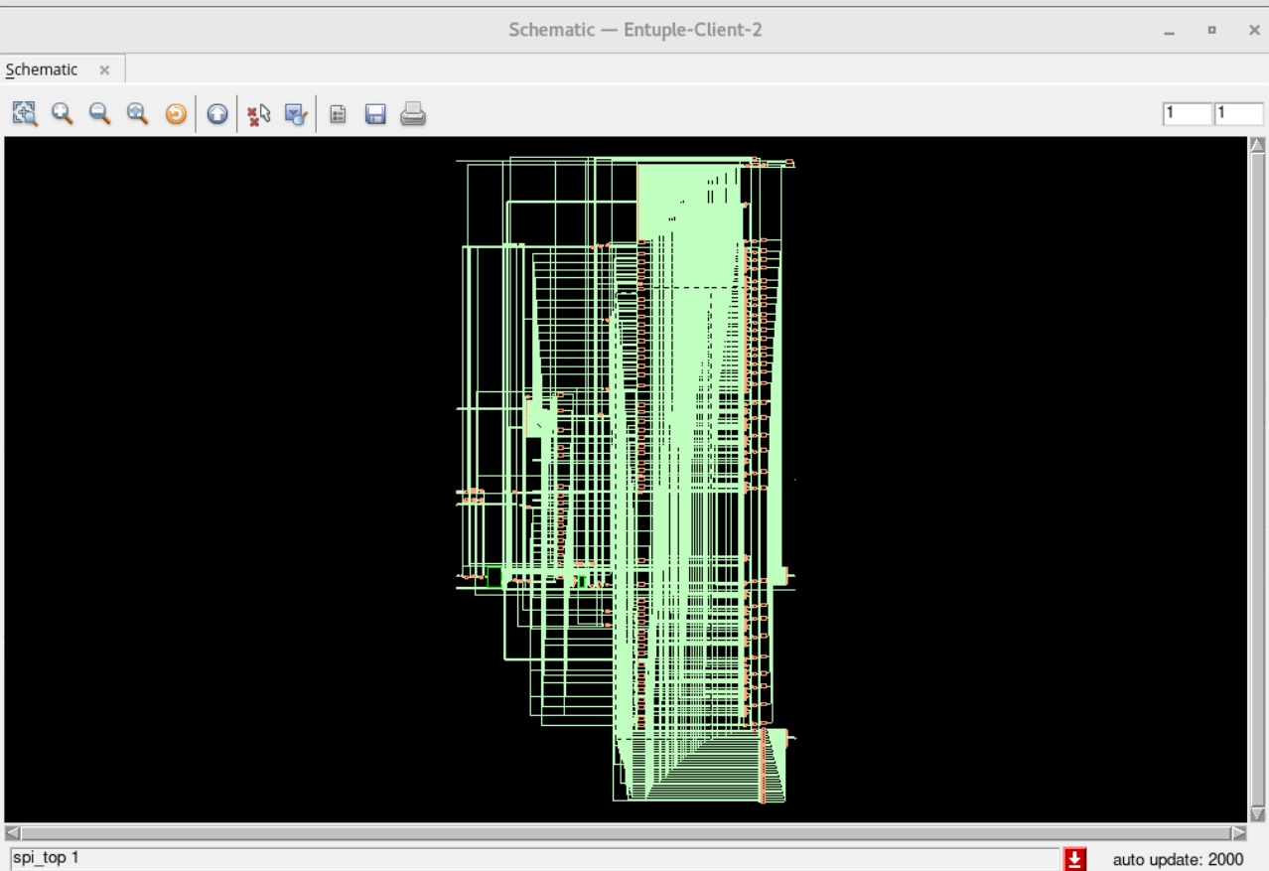
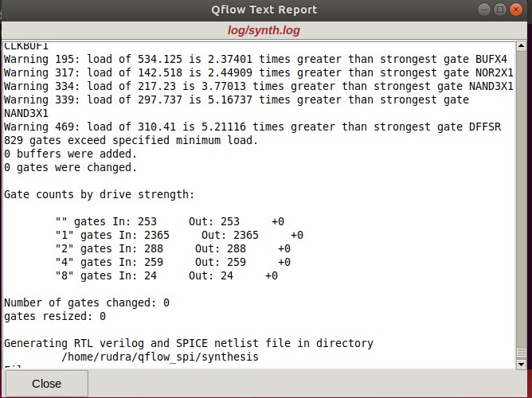
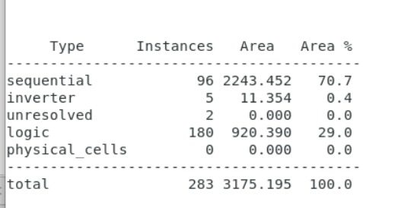
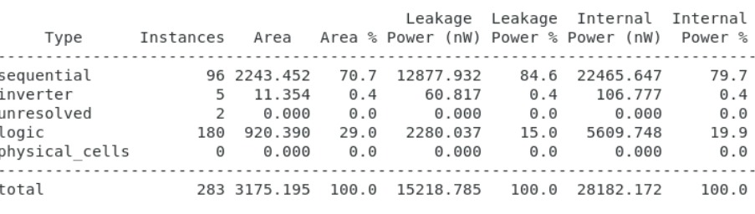
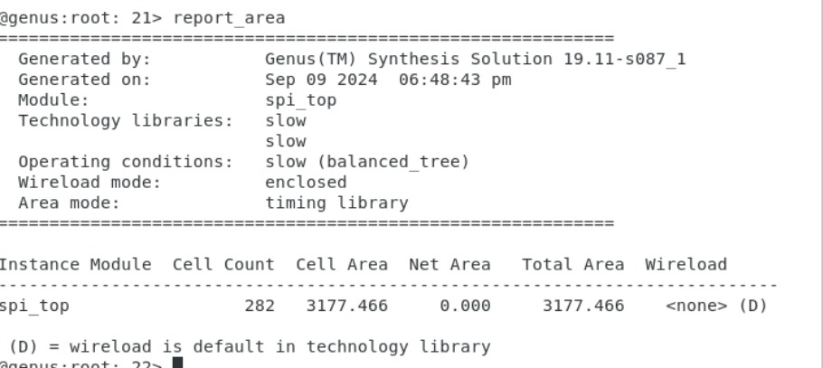
Notes:
Gate counts by drive strength: This is showing how many gates are present in the design, categorized by their drive strength. Drive strength indicates the output current capability of the gate.
"" gates: These are gates without a specified drive strength. In this case, there are 253 gates both at input ("In") and output ("Out").
"1" gates: These have a drive strength of "1". There are 2365 gates at both input and output.
"2" gates: Gates with drive strength "2" have 288 gates.
"4" gates: For drive strength "4", there are 259 gates.
"8" gates: Gates with drive strength "8" have 24 gates.
The numbers after In and Out indicate the count of gates at the input and output, respectively. In this case, the numbers are equal for both inputs and outputs, meaning no changes occurred in the design during this phase.
The +0 shows that no gates have been added, resized, or changed in the respective drive strength category.
Number of gates changed: 0: No gates were modified.
Gates resized: 0: This indicates that no gates were resized in terms of their drive strength.
In digital circuit design, drive strength (not "drive length") refers to the current driving capability of a logic gate, such as an inverter or NAND gate. It defines how much current a gate can supply to its output when switching between logic states (from 0 to 1 or 1 to 0).
The drive strength of a gate impacts how fast it can charge or discharge the load (which consists of other gates or components connected to its output), affecting the overall speed of the circuit. It is usually indicated by a number that represents how much stronger the gate is compared to a base drive strength (often labeled as "1").
For example:
A gate with drive strength 1 is the base unit of drive strength, capable of driving a certain amount of load.
A gate with drive strength 2 can drive twice as much load as the base drive strength.
A gate with drive strength 4 can drive four times as much load, and so on.
Increasing the drive strength allows a gate to switch faster when driving larger loads, but it also increases the power consumption and area of the gate. The designer typically chooses the appropriate drive strength to balance performance and power consumption in the design.

Slide 15
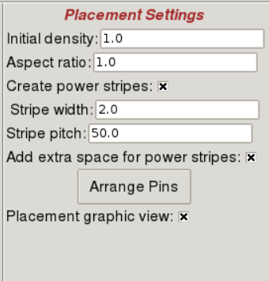
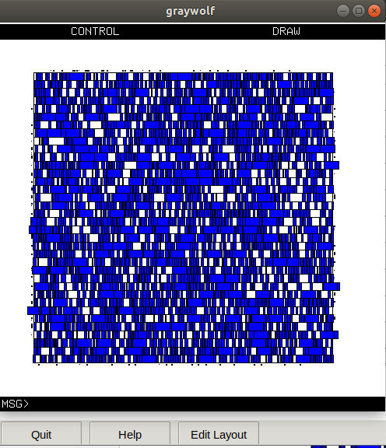
Placement
Place the synthesized netlist components into the predefined chip area.
Various Parameter we have to create like:
Initial density
Aspect ratio
Create power strips VDD , VSS
Stripe Width and Pitch
Arrange pins
End cap cells
Well Tap cells
Fill gaps between the cells

Slide 16
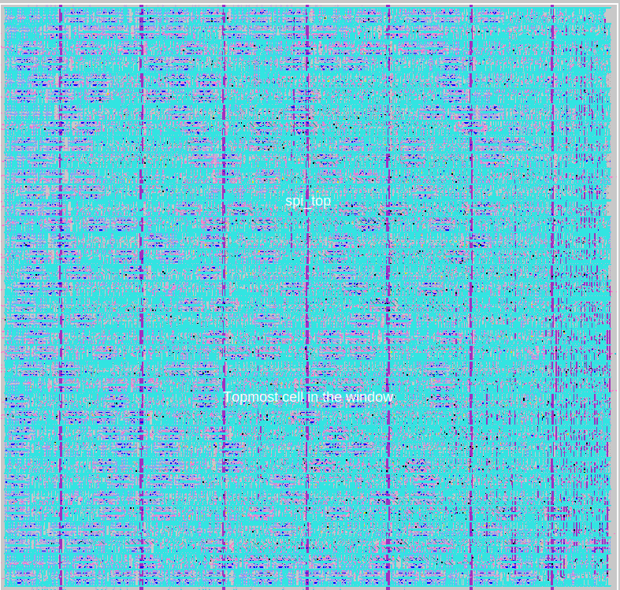
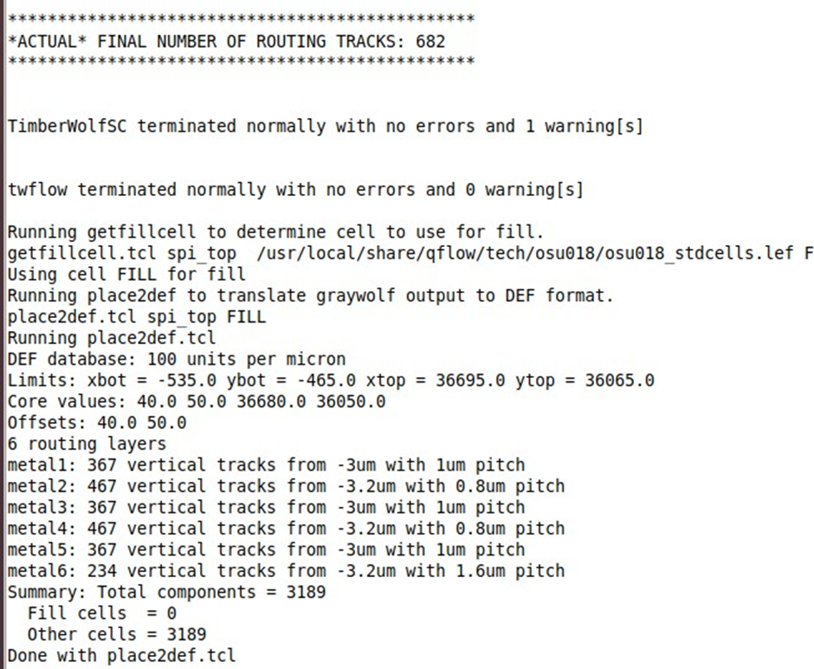
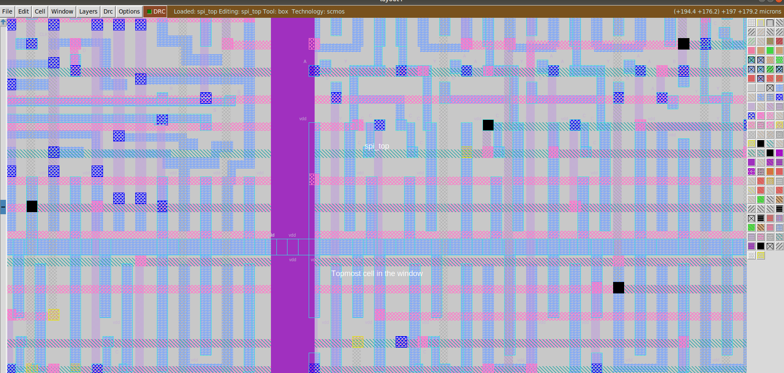

Slide 17
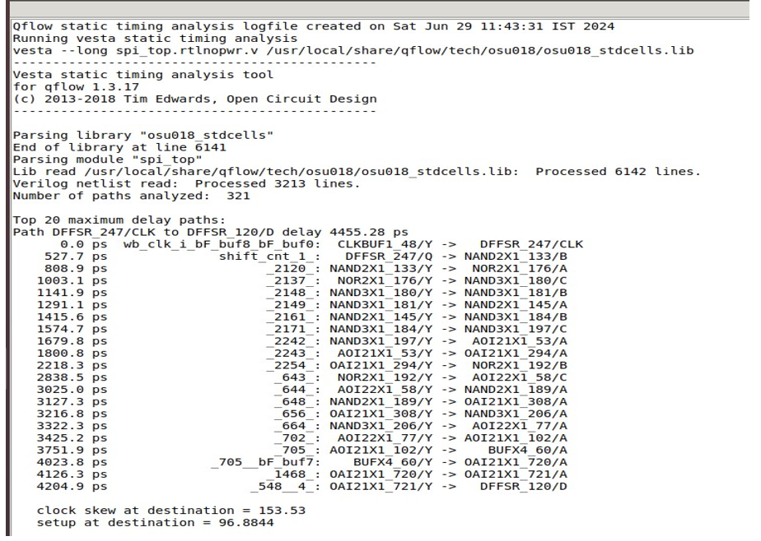
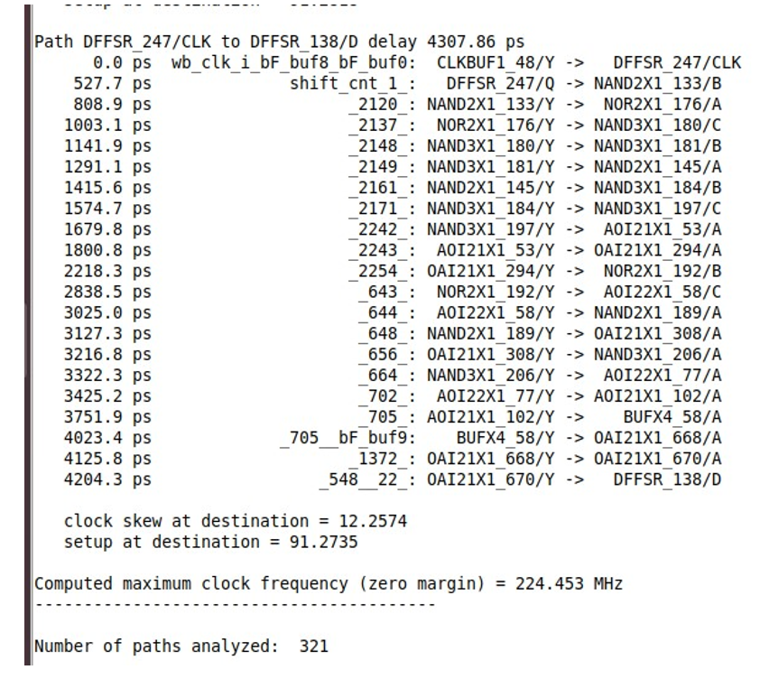
Static Timing Analysis
Objective: Verify that the placed design meets timing requirements.
Steps:
Perform Static Timing Analysis using the generated netlist.
Analyze timing constraints and identify any violations.
Notes:
Setup time is the required time duration that the input data MUST be stable before the triggering-edge of the clock
Hold time is the required duration that the input data MUST be stable after the triggering edge of the clock.

Slide 18
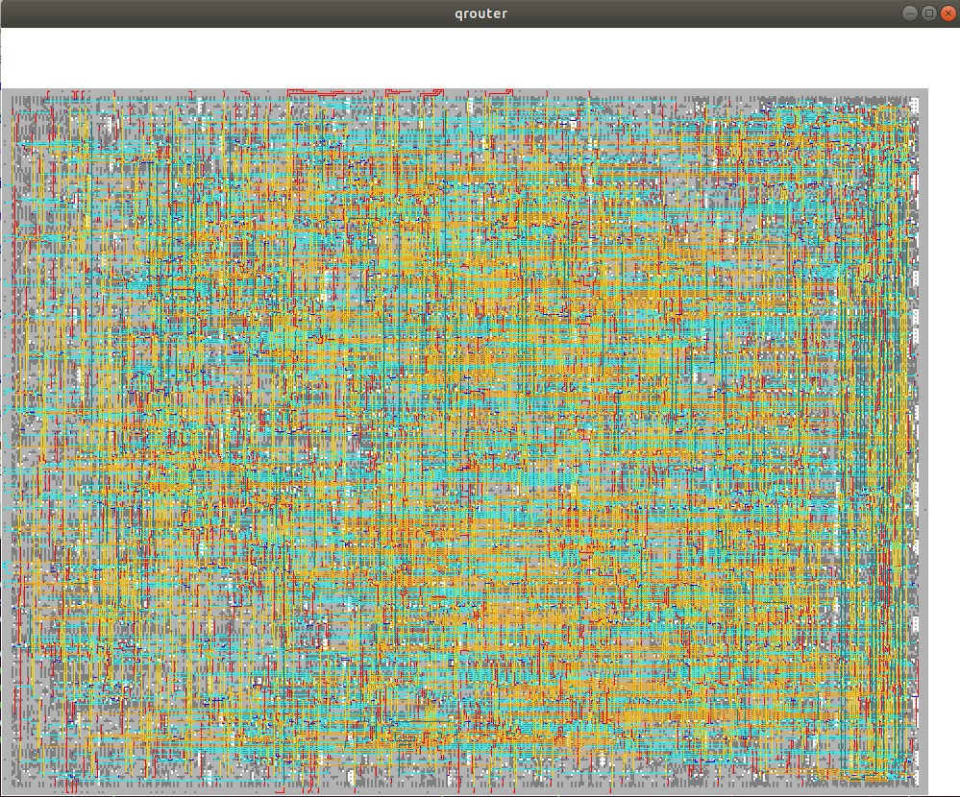
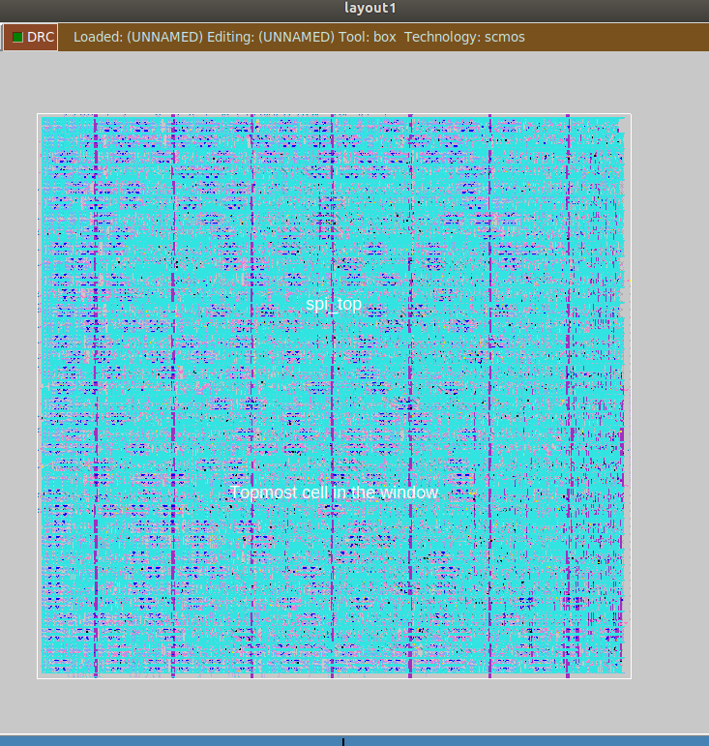
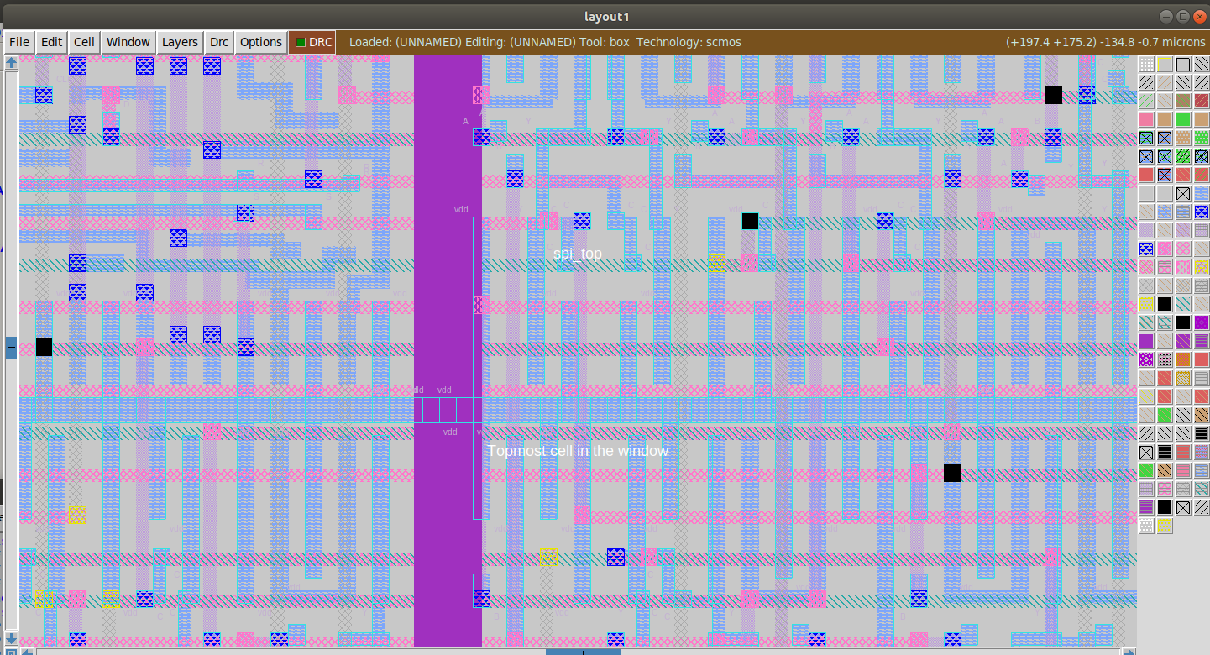
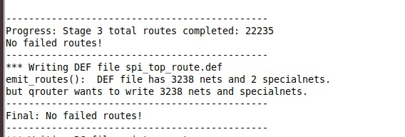
Routing

Slide 19
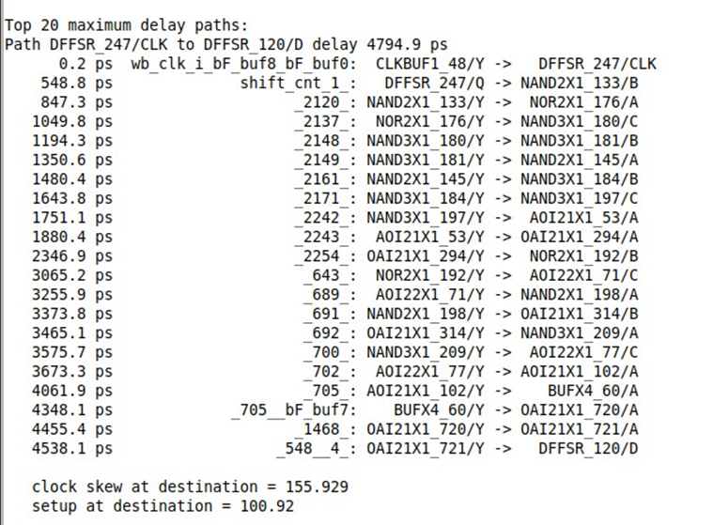
Post-Route STA

Slide 20
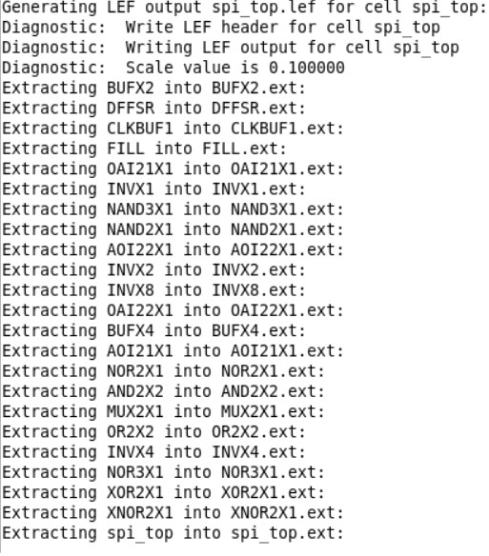
Migration

Slide 21
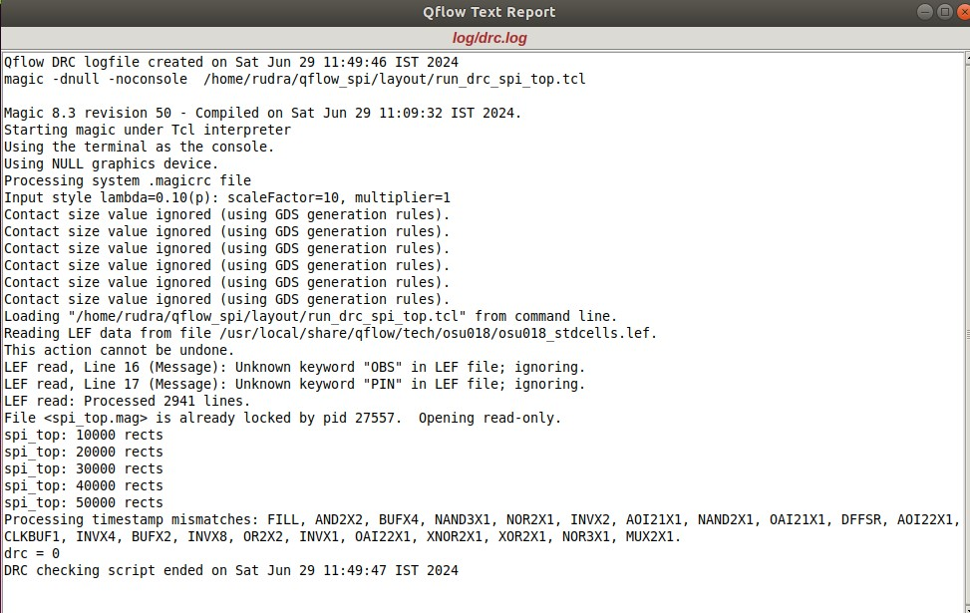
DRC

Slide 22
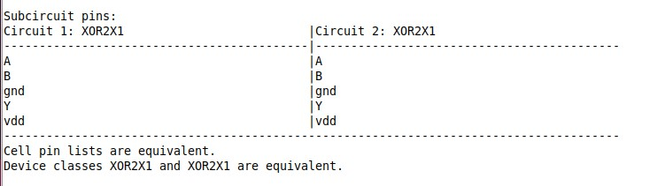
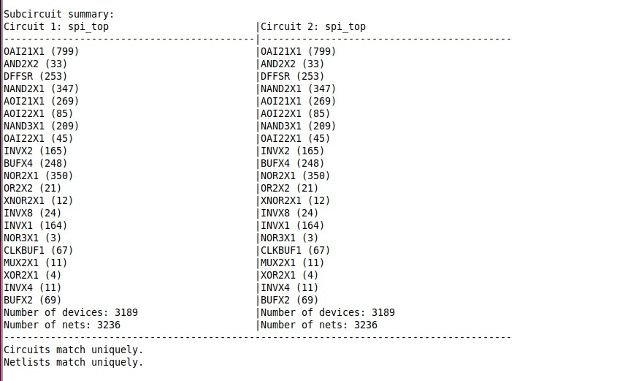
Layout vs Schematic (LVS)

Slide 23
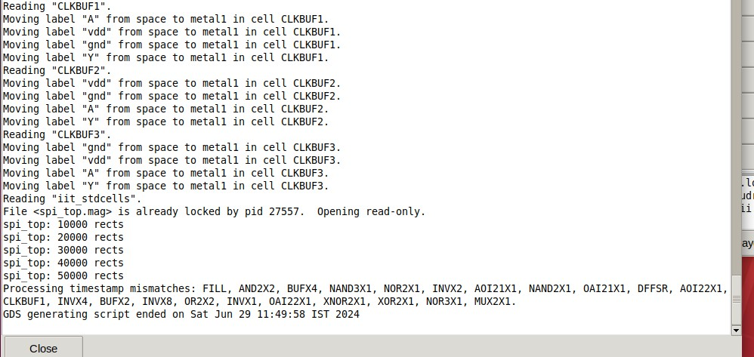
GDSII Generation

Slide 24
Clean Up

Slide 25
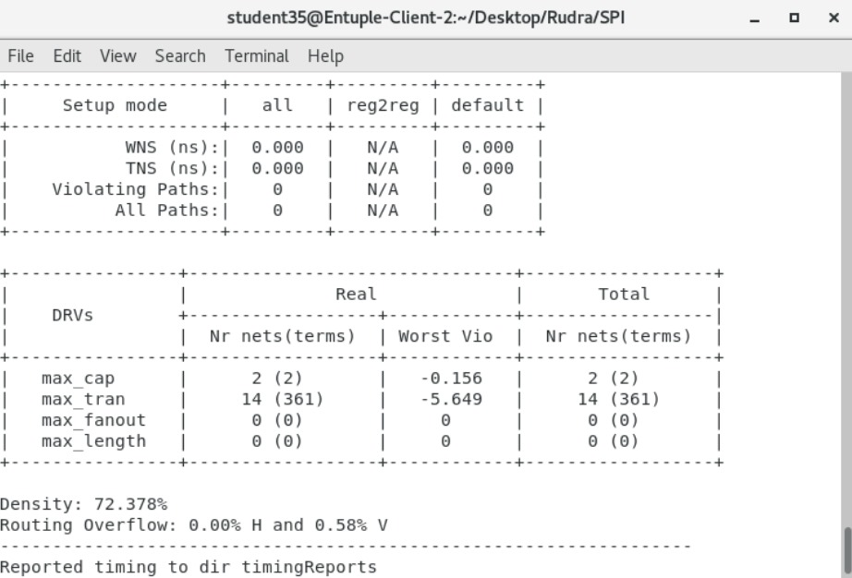
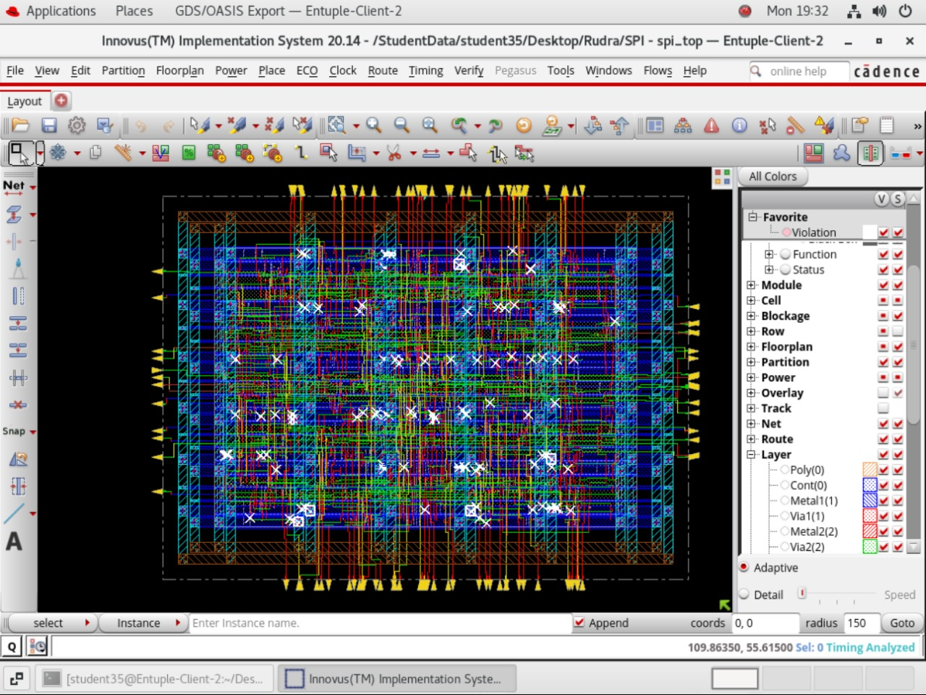
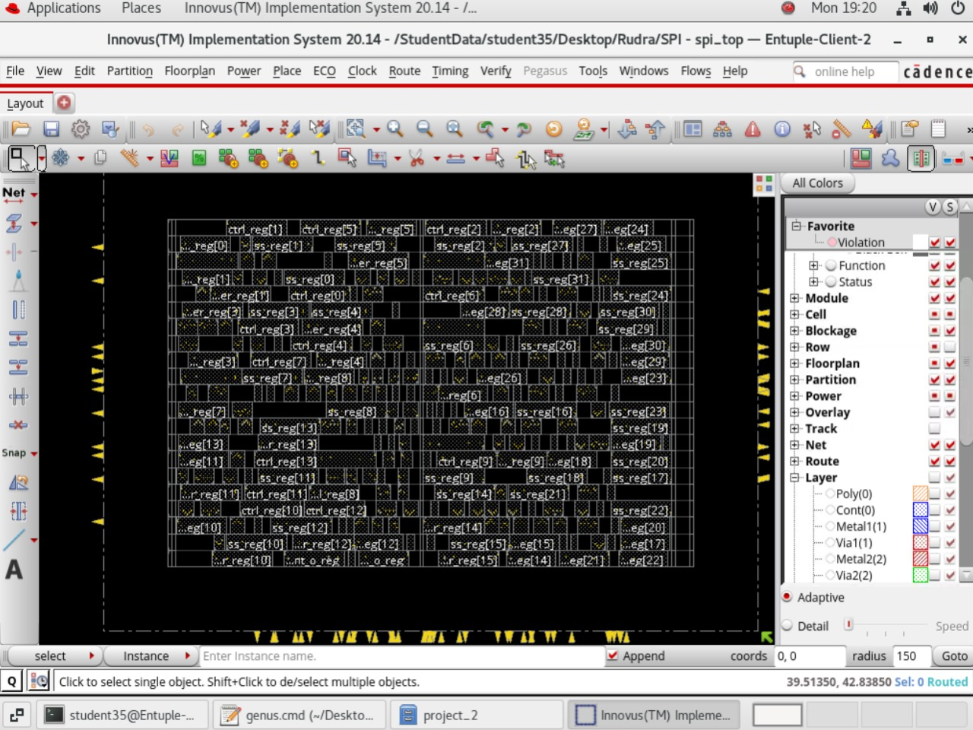
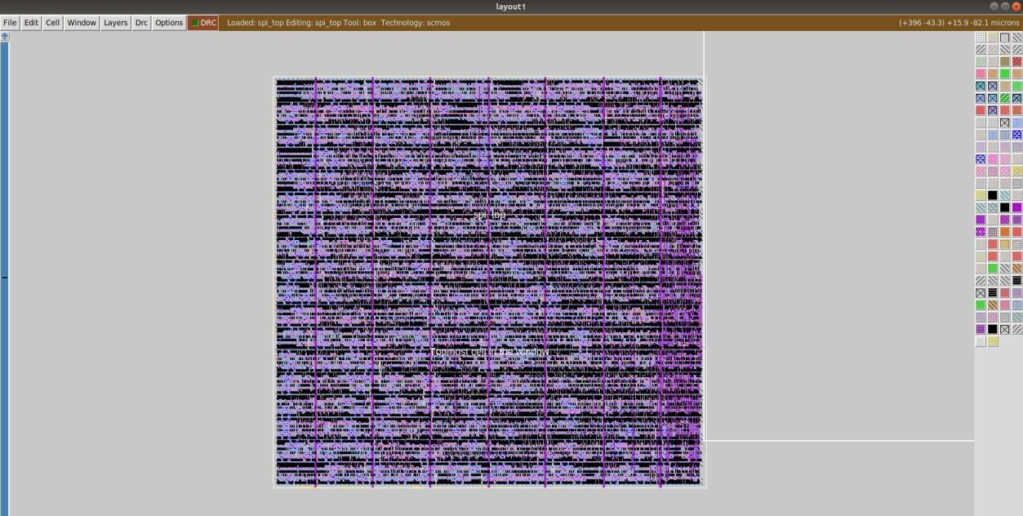
Conclusion
The physical design implementation of the SPI using Qflow was executed successfully. Each stage, from synthesis to final GDSII generation, was completed without significant issues. The design passed all verification steps, demonstrating the effectiveness of Qflow for VLSI design automation.

Slide 26
Thank you

